Slide 1
SHIFT AND ROTATE
Course Code: 0052
Course Title: Computer Organization and Architecture
Dept. of Computer Science
Faculty of Science and Technology
Lecturer No: | 7(b) | Week No: | 10 | Semester: | Summer 23-24
Lecturer: | Md. Faruk Abdullah Al Sohan; faruk.sohan@aiub.edu

Slide 2

Overview: ROTATE
Rotates work like the shifts, except that when a bit Is shifted out one end of an operand it is put back in the other end.
These instructions can be used to examine and/or change bits or groups of bits.
*** Logic, shift, and rotate instructions is used to do binary and hexadecimal I/O.
The ability to read and write numbers will let us solve a great variety of problem.

Slide 3
Example SHR
Problem: Suppose DH contains 8Ah and CL contains 2. What are the values of DH and CF after the Instruction SHR DH,CL is executed?
Solution: The value of DH in binary is 10001010.
After two right shifts, CF=1
The new value of DH is obtained by erasing the rightmost two bits and adding two 0 bits to the left end, thus DH =00100010b = 22h.

Slide 4
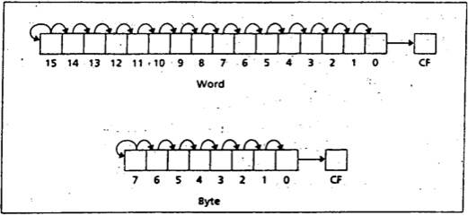
SAR Instruction
The SAR Instruction (shift arithmetic right) operates like SHR , with one difference: the msb retains Its original value. The syntax is:
SAR destination,1
SAR destination, CL

Slide 5
Division by Right Shift
A Left shift doubles the destination's value,
Similarly, it’s reasonable to guess that a right shift might divide it by 2. This Is correct for even numbers.
For odd numbers, a right shift halves it and rounds down to the nearest integer.
For example, if BL contains 00000101 = 5, then after a right shift. BL will contain 00000010 = 2

Slide 6
Signed and Unsigned Division
In case of division by right shifts, we need to make a distinction between signed and unsigned numbers.
If an unsigned interpretation is being given, SHR should be used.
For a signed interpretation, SAR must be used, because it preserves the sign.
Problem: Use right shifts to divide the unsigned number 65143 by 4. Put the quotient in AX
To divide by 4, two right shifts are needed. Since the dividend is unsigned, we use SHR. The code is
MOV AX, 65143
MOV CL, 2
SHR AX,CL

Slide 7
SAR
Example: If AL contains -15, give the decimal value of AL after SAR AL,1 is performed.
Solution: Execution of SAR AL,1 divides the number by 2 and rounds down.
Dividing -15 by 2 yields -7.5, and after rounding down we get -8.
In terms of the binary contents, we have -15=11110001b. After shifting, we have 11111000b= -8.
*** We will see some MUL and DIV for multiplication operations that are not limited to power of 2 only. However, MUL and DIV is much slower than SHIFT operation

Slide 8
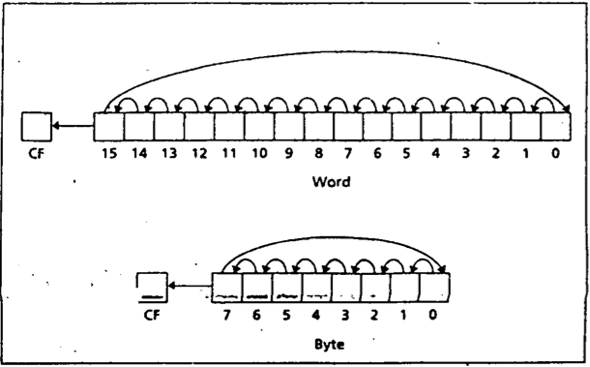
Rotate Instructions
The instruction ROL (rotate left) shifts bits to the left. The msb shifted into the rightmost bit.
The CF also gets the bit shifted out of the msb.
You can think of the destination bits forming a circle, with the least significant bit following the msb in the circle.
ROL destination, 1
and
ROL destination, CL

Slide 9
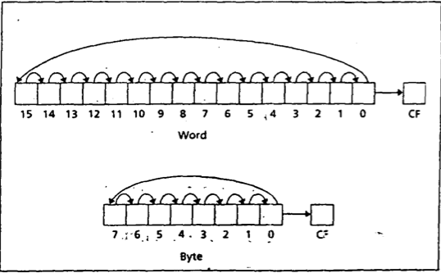
Rotate Right (ROR)
The instruction ROR (rotate right) works just like ROL except that the bits are rotated to the right.
The rightmost bit is shifted into the msb, and also into the CF
ROR destination, 1
and
ROR destination, CL

Slide 10
ROL, ROR and CF
In ROL and ROR, CF reflects the bit that is rotated out.
ROL and ROR can be used to inspect the bits in a byte or word, without changing the contents.
Example: Use ROL to count the number of 1 bits in BX, without changing BX. Put the answer in AX.
Solution:
XOR AX,AX
MOV CX,16
TOP:
ROL BX,1
JNC NEXT
INC AX
NEXT:
LOOP TOP

Slide 11
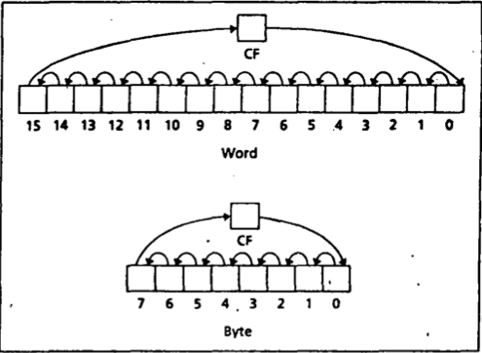
RCL (Rotate Carry Left)
The Instruction RCL (Rotate through Carry LEFT) shifts the bits of the destination to the left.
The msb is shifted Into the CF and the previous value of CF is shifted Into the rightmost bit.
In other words, RCL works like Just like ROL, except that CF is part of the circle of bits being rotated. The syntax is:
RCL destination,1
and
RCL destination, CL

Slide 12
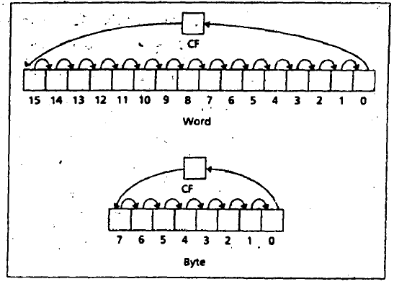
RCR (Rotate Carry Right)
The Instruction RCR (Rotate through Carry RIGHT) works just like RCL except the bits are rotated to the right. The syntax is:
RCR destination,1
and
RCR destination, CL

Slide 13
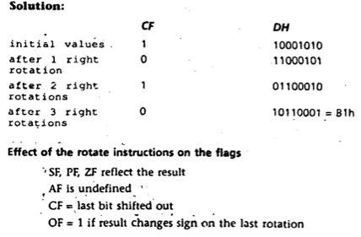
Example
Suppose DH contains 8Ah, CF= 1, and CL contains 3.
What are the values of DH and CF after the instruction RCR DH,CL is executed?

Slide 14
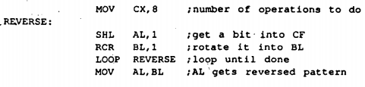
Reversing Bit Pattern Application
Expectation: If AL contains 11011100, we want to make it 00111011
Use SHL to shift the bits out the left end of AL Into CF.
Then use RCR to move them Into the left end of another register (i.e. BL)
Run the above operation 8 times for 8 bits

Slide 15
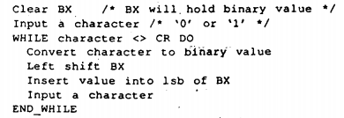
Binary and Hex Input & Output
Binary Input: Lets assume a program reads In a binary number from the keyboard, followed by a carriage return. [i.e. string of 0’s and 1’s]
Conversion in bit value needs to be done as soon as the input character is entered.
After that collect the bits in register.
To read a binary number from keyboard and store it in BX:

Slide 16
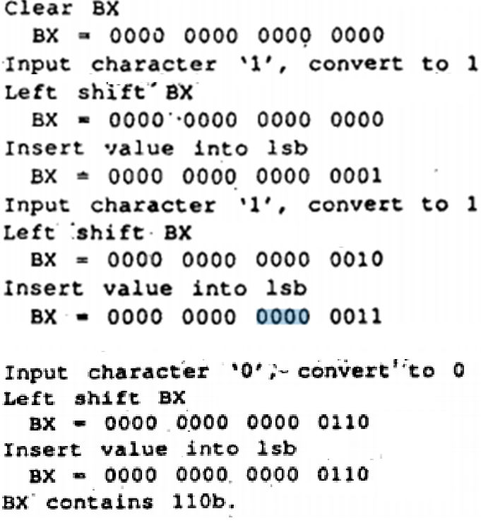
Example: Process Input 110

Slide 17
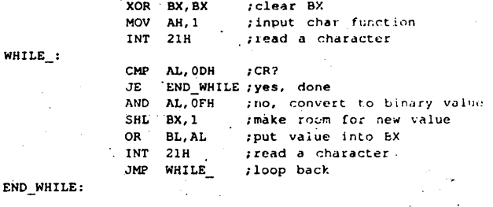
Assembly Conversion for input processing (110)

Slide 18
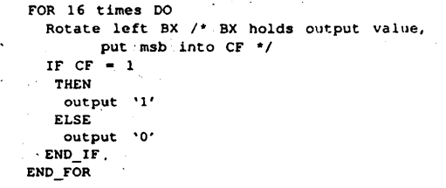
Binary Output
Outputting the contents of BX in binary also involves the shift operation.
Algorithm for Binary output:
Write an assembly code to process the Binary output for this problem.

Slide 19
Hex Input
Hex input consists of digits ("0" to "9") and letters ("A" to "F”) followed by a carriage return.
For simplicity, we will assume that
Only uppercase letters are used, and
The user inputs no more than four hex characters.
The process of converting characters to binary values is more Involved than it was for binary input, and BX must be shifted four times to make room for a hex value.

Slide 20
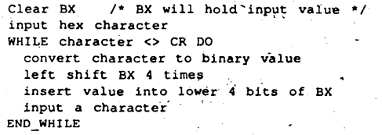
Algorithm for hex input

Slide 21
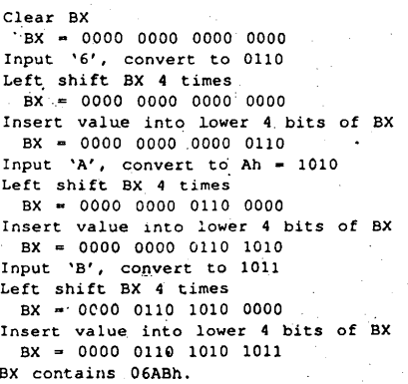
Example: input 6AB

Slide 22
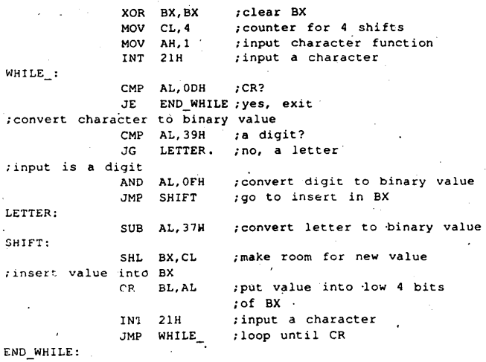
Assembly Code for Processing 6AB

Slide 23
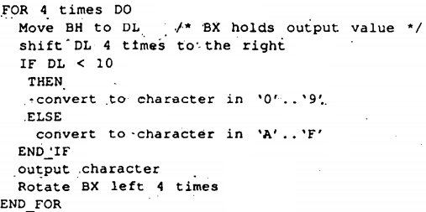
Algorithm for Hex Output

Slide 24
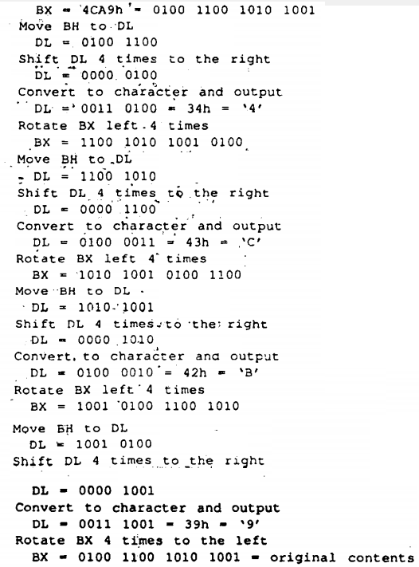
Conversion of 4CA9h to Binary
Write an assembly code to process the Binary output for this problem.

Slide 25
References
Assembly Language Programming and Organization of the IBM PC, Ytha Yu and Charles Marut, McGraw Hill, 1992. (ISBN: 0-07-072692-2).
http://faculty.cs.niu.edu/~byrnes/csci360/notes/360shift.htm

Slide 26
Books
Assembly Language Programming and Organization of the IBM PC, Ytha Yu and Charles Marut, McGraw Hill, 1992. (ISBN: 0-07-072692-2).
Essentials of Computer Organization and Architecture, (Third Edition), Linda Null and Julia Lobur
W. Stallings, “Computer Organization and Architecture: Designing for performance”, 67h Edition, Prentice Hall of India, 2003, ISBN 81 – 203 – 2962 – 7
Computer Organization and Architecture by John P. Haynes.

